Slide 1
Week One - Introduction
Who’s who?
Overview
Handy life Hacks
Staying organized
Tips and advice

Slide 2
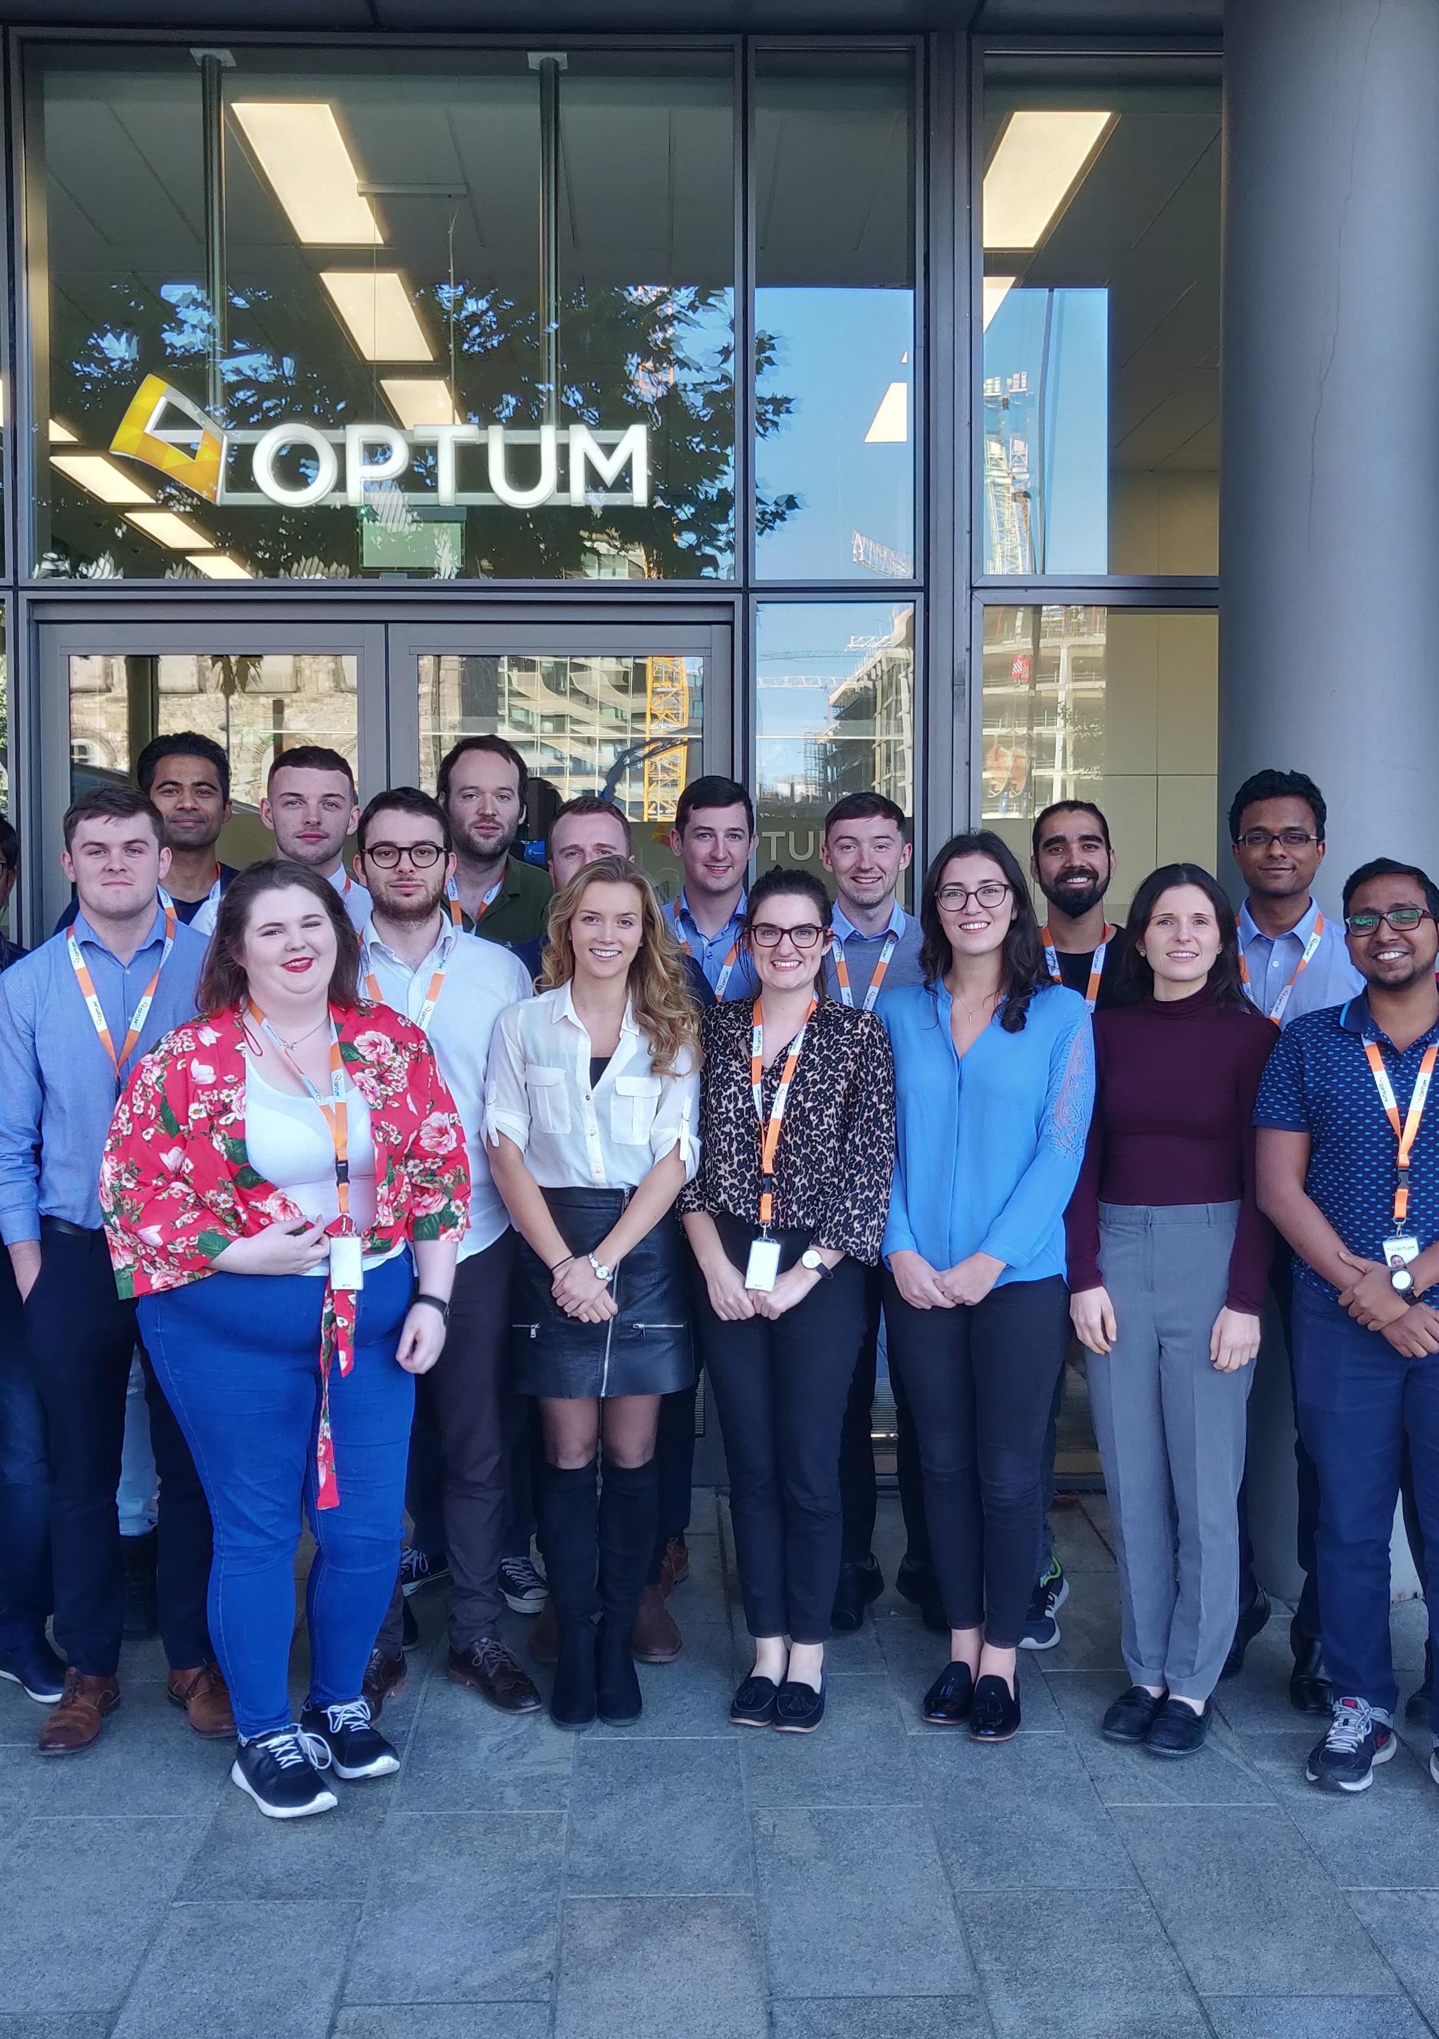
Introduction
My name is Aaron Ward
Joined as a TDP’er in September 2018
I’ll be doing working sessions with you over the next few weeks
WHY?
To give you a head start on your careers
Make your lives a little easier

Slide 3
Other mentors
Mariah Sonja | Megan O'Brien
Rachel Costello | Paul Hegarty
Ronan McCormack | Paul Good
Vikas Prasanna | Fergal Coll
Louise O'Connor | Sean Grace
Liam Maguire | Clara Quigley
Dominik Dahlem
The Format
Super informal
This isn’t going to be a class

Slide 4
Lets get started
Secure is a portal where employees request access to user groups
This could be: a database, team server, admin privileges etc.
How to make a secure request?
https://secure.uhc.com/
Click the type you want
Fill in form
Now, you play the waiting game
Example : WebAuthStreaming_Media (Protip - this will give you access to youtube)

Slide 5
installing software
https://appstore.uhc.com/
This is for “certified” apps
You might need admin access
Mac_Admin
Theoretically, this would let you install non-AppStore approved software on your laptop (like Spotify)
Which you should never do ☺
How To: Open SelfService → Admin Access Enablement → Re-Add Access

Slide 6
Tips to on staying organized
Apple Notes
great for documenting video tutorials, meetings, quick one liners during calls
Document your contacts - People you meet along the way
Trello
Don’t waste paper ☺
Use Trello to write up a TO-DO lists
http://trello.com
Wiki Personal Space
great for writing private docs for personal use
I use to document all the things I’ve done over the year - keep track for your MAP review
Better text editing tools than notes

Slide 7
Life advice for a junior dev
Do as much public speaking as possible
Go to as much technical talks as possible – Dev days, demos, conferences etc.
Don’t sign up for too many projects
It’s better to devote more time to projects (provide more valuable work)
2 (maybe 3) is enough
Be patient
Don't get frustrated if you aren't working on something you want for a while
Being a grad starts off slow
Don’t be afraid to ask for help
Everyone is learning
No one knows everything
Mistakes are what make skills

